Slide 1
Digital Circuits and Systems Lecture 14 Wrapup
Tian Sheuan Chang

Slide 2
Restoring logic gives noise margins

Slide 3
Represent values with bits
Truth values, e.g., door is open
Single bit
Numbers, temperature (range, precision)
Integers, fixed-point, floating-point
Sets, e.g., colors
Encoded one-hot or binary
Compound
Includes several of above

Slide 4
Combinational Logic
We compose gates into combinational logic circuits Output depends only on present value of inputs
This circuit realizes the function f= _______________
Why don’t we realize this function with a single gate?

Slide 5
Functions built from decoders and other blocks
Example – find maximum of 256 small 4-bit numbers
Decode each number 4→16 bits (256 times)
OR these together w/16 256-bit ORs
(each a 4-level tree of 4-input ORs)
Use an Arbiter to get highest of 16
Encode the 16→4
Need to see if this is more efficient than a tournament
Can this determine which input has the ‘winning’ number?
Decode
OR
Arbiter
Encode

Slide 6
Building Blocks

Slide 7
Iterative Circuits

Slide 8
Arithmetic

Slide 9
Sequential Logic
Sequential logic circuits have state. Next state and outputs are a function of inputs and present state.

Slide 10
Sequential circuits work properly if setup and hold time constraints are met
Suppose t_{dCQ} = t_{s} = t_{h} = 100ps, t_{k} = 200ps or –200ps,
t_{min} = 50ps, t_{max}=2ns.
Is hold time met? What is minimum t_{cy} ?

Slide 11
Finite-State Machines
Finite-state machines are described by a next-state and output function Can be described with a state diagram or state table.

Slide 12
¬carew
//------------------------------------------------------
// Traffic_Light
// Inputs:
// clk - system clock
// rst - reset - high true
// carew - car east/west - true when car is waiting in east-west direction
// Outputs:
// lights - (6 bits) {gns, yns, rns, gew, yew, rew}
// Waits in state GNS until carew is true, then sequences YNS, GEW, YEW
// and back to GNS.
//------------------------------------------------------
module Traffic_Light(clk, rst, carew, lights) ;
input clk ;
input rst ; // reset
input carew ; // car present on east-west road
output [5:0] lights ; // {gns, yns, rns, gew, yew, rew}
wire [`SWIDTH-1:0] state, next ; // current and next state
reg [`SWIDTH-1:0] next1 ; // next state w/o reset
reg [5:0] lights ; // output - six lights 1=on
// instantiate state register
DFF #(`SWIDTH) state_reg(clk, next, state) ;
// next state and output equations - this is combinational logic
always @(state or carew) begin
case(state)
`GNS: {next1, lights} = {(carew ? `YNS : `GNS), `GNSL} ;
`YNS: {next1, lights} = {`GEW, `YNSL} ;
`GEW: {next1, lights} = {`YEW, `GEWL} ;
`YEW: {next1, lights} = {`GNS, `YEWL} ;
endcase
end
// add reset
assign next = rst ? `GNS : next1 ;
endmodule
carew
//---------------------------------------------
// FSM Example for Lecture 7
// Bill Dally 1/30/03
//---------------------------------------------
// define state assignment - one hot
//---------------------------------------------
`define SWIDTH 4
`define GNS 4'b1000
`define YNS 4'b0100
`define GEW 4'b0010
`define YEW 4'b0001
//---------------------------------------------
// define output codes
//---------------------------------------------
`define GNSL 6'b100001
`define YNSL 6'b010001
`define GEWL 6'b001100
`define YEWL 6'b001010
//---------------------------------------------
// define flip-flop
//---------------------------------------------
module DFF(clk, in, out) ;
parameter n = 1; // width
input clk ;
input [n-1:0] in ;
output [n-1:0] out ;
reg [n-1:0] out ;
always @(posedge clk)
out = in ;
endmodule

Slide 13
Data paths are more easily described by realizing the next state function from building blocks

Slide 14
module Timer(clk, rst, load, in, done) ;
parameter n=4 ;
input clk, rst, load ;
input [n-1:0] in ;
output done ;
wire [n-1:0] count, next_count ;
wire done ;
DFF #(n) cnt(clk, next_count, count) ;
always@(rst, load, in, out) begin
casex({rst, load, done})
3'b1xx: next_count = 0 ; // reset
3'b001: next_count = 0 ; // done
3'b01x: next_count = in ; // load
default: next_count = count-1’b1; // count down
endcase
end
assign done = (count == 0) ;
endmodule

Slide 15
Factoring
Factor Machines to reduce complexity Divide and conquer

Slide 16
Most FSMs are a combination of a data path realized from building blocks, and a controller designed from a state diagram.

Slide 17
Microcode
Microcode, realizing a FSM with a memory - a programmable FSM
Compress the size of the memory by encoding control and output instructions

Slide 18
System Design – a process
Specification
Understand what you need to build
Divide and conquer
Break it down into manageable pieces
Define interfaces
Clearly specify every signal between pieces
Hide implementation
Choose representations
Timing and sequencing
Overall timing – use a table
Timing of each interface – use a simple convention (e.g., valid – ready)
Add parallelism as needed (pipeline or duplicate units)
Timing and sequencing (of parallel structures)
Design each module
Code
Verify
Iterate back to the top at any step as needed.

Slide 19
DES Example

Slide 20
Pipelining
Modules are composed in pipelines and parallel configurations
Throughput and latency

Slide 21
How does a typical pipeline handshake work? What signals are used between stages? What values must these signals have for data to move from one stage to the next?

Slide 22
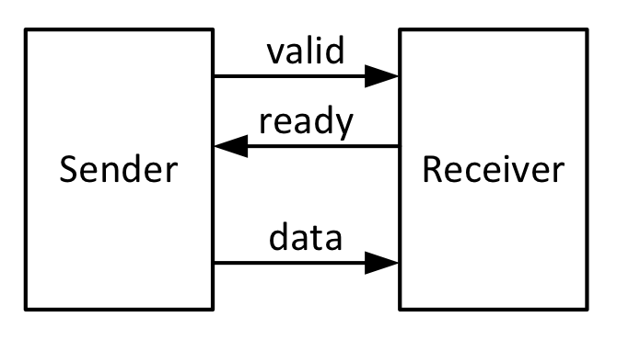
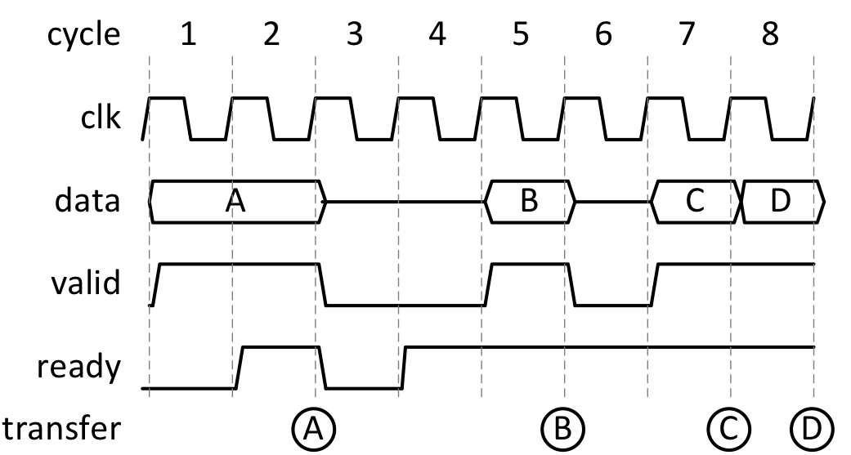
Flow Control

Slide 23
Pipelines
Pipelines can stall and idle
When do these happen? How can you prevent them

Slide 24
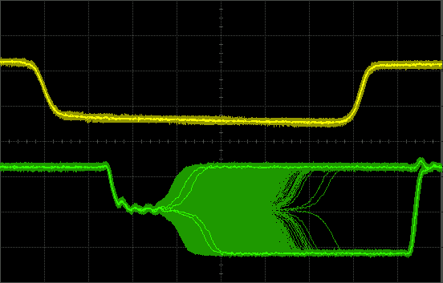
Synchronization Failure

Slide 25
Failure Probability and Error Rate
Each event can potentially fail.
Failure rate = event rate x failure probability

Slide 26
What is wrong with this picture?

Slide 27
Asynchronous logic design
Continuous state feedback
Affected by races and hazards
Synthesize/Analyze with flow tables

Slide 28
Congratulations! You are now a logic designer.
To become a better one:
Practice, practice, practice…
Study other designs
Become a student of the art of digital design
Stay on top of the latest technology
New parts, processes, tools, techniques
Read the trade press
Take more courses
Go to conferences
Build a “network” (of people)
Continue learning
What you have now is a “license to learn”
It’s a fun field
Design lots of neat things – chips, boards, systems
Play with fun tools, processes, chips, lab equipment
Meet fun people (mostly)
Make $$

